Slide 1


H eart Disease Analysis
PRESENTED BY - JAI GANESH K

Slide 2



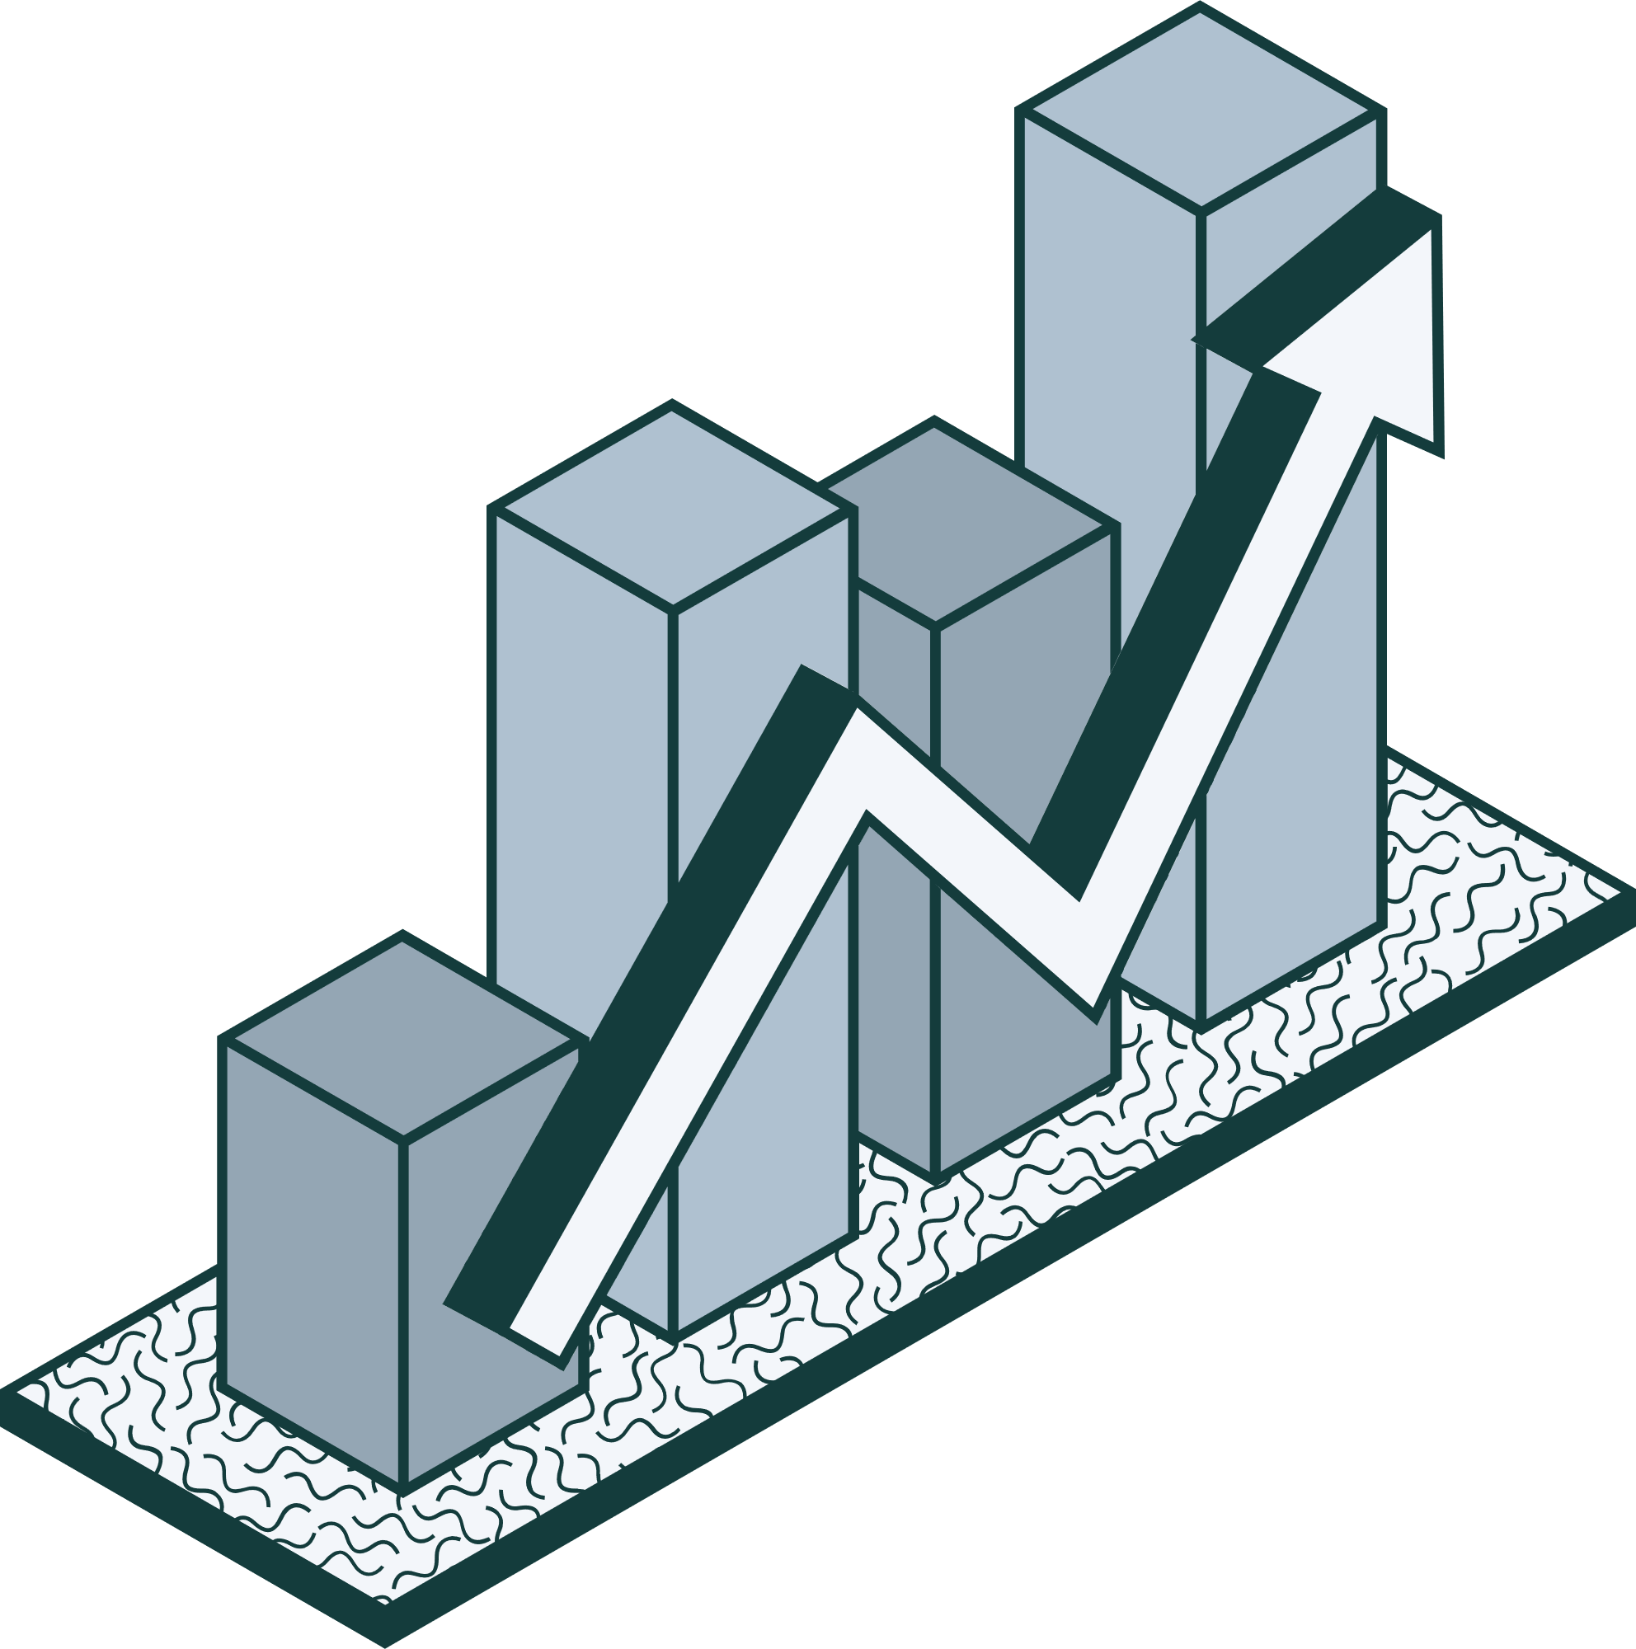

INTRODUCTION
Health is real wealth in the pandemic time we all realized the brute effects of covid-19 on all irrespective of any status. You are required to analyze this health and medical data for better future preparation.
This data shows the heart disease among the population and other metrics.

Slide 3

PROBLEM STATEMENT
Health is real wealth in the pandemic time we all realized the brute effects of covid-19 on all irrespective of any status. You are required to analyze this health and medical data for better future preparation.
Do ETL: Extract- Transform and Load data from the heart disease diagnostic database You can perform EDA through python. The database extracts various information such as Heart disease rates, Heart disease by gender, by age. You can even compare attributes of the data set to extract necessary information.
Make the necessary dashboard with the best you can extract from the data.
Use various visualization and features and make the best dashboard Find key metrics and factors and show the meaningful relationships between attributes.

Slide 4
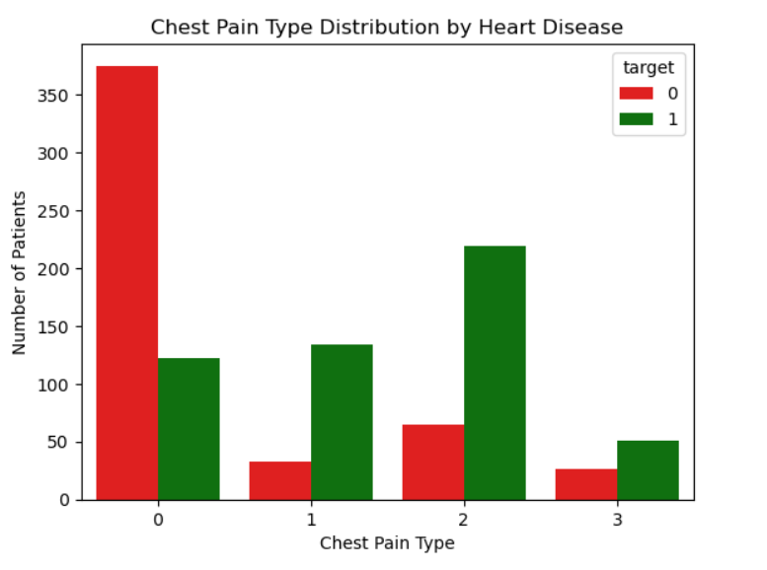
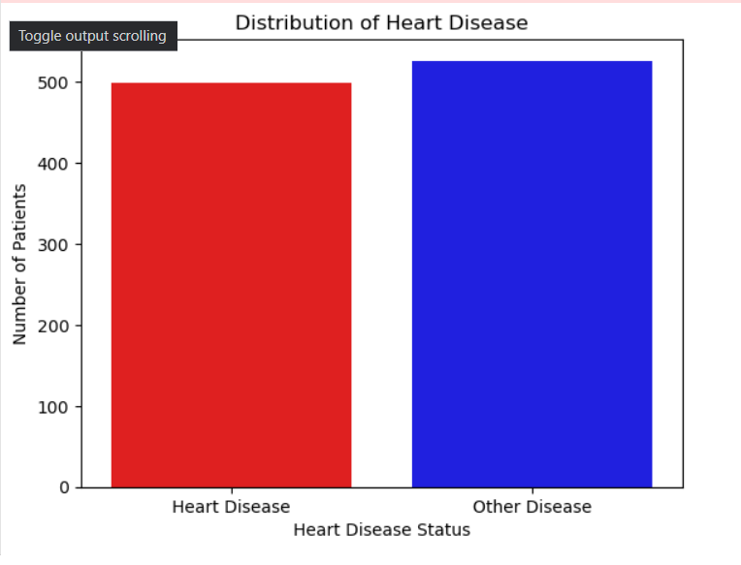
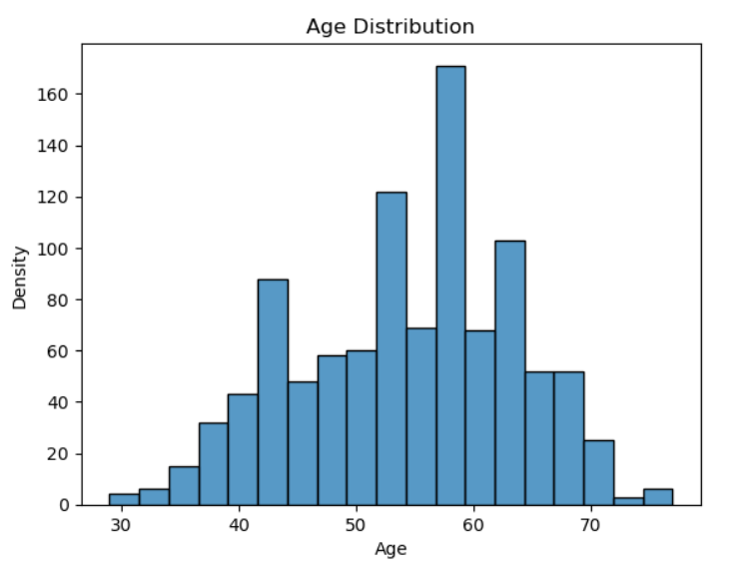
Visualizing Insights with Pandas

Slide 5
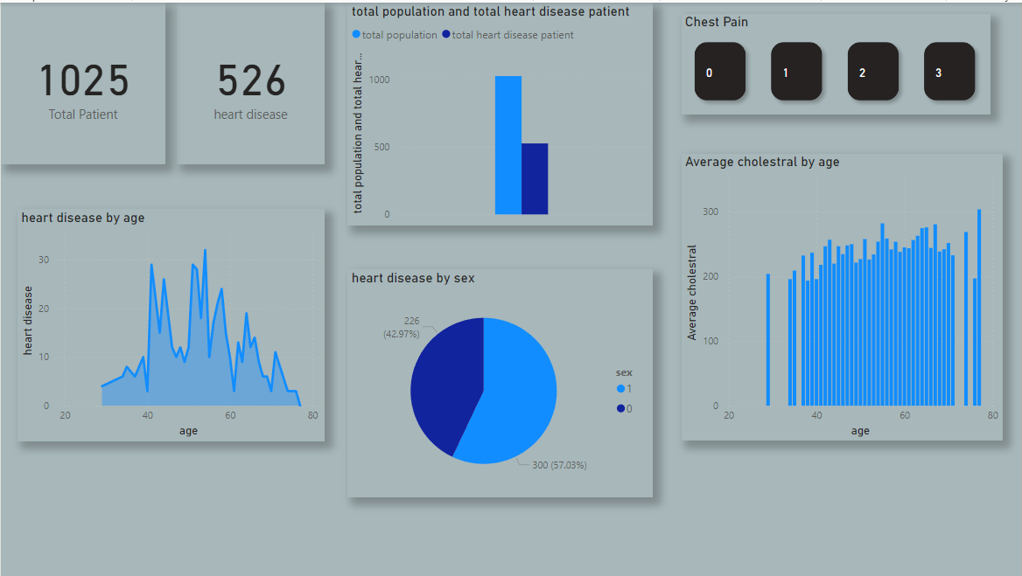
Visualizing Insights with Power BI

Slide 6
Key performance indicator
Percentage of People suffering from Heart disease.
Heart Disease based on Age and Gender.
Type of chest pain in hear disease patients distribution of
different types of chest pain.
Blood pressure and Cholesterol level of the people with Heart Disease according to age and gender.
ST depression experienced by the people according to the Age, Gender and absence or presence of Heart disease.

Slide 7
INSIGHTS GENERATED
Around 45.87% of the population suffers from heart disease.
Males are more prone to heart disease
From the data, it was observed that people having asymptomatic chest pain have a higher chance of heart disease.
It was also seen that the male population has slightly higher BP.
we observed that the blood pressure is normal at 30 to 50 years of age and after 50 years it increases gradually to the age of 60. And also after the age of 55 years, it fluctuates drastically.
It was seen that the Cholesterol level slightly starts increasing at the age of 45 and shows more fluctuation in male than female
Depression levels are quite high in the age group of 30 to 40 and 55 to 70. And in the age group of 40 to 55, it remains stable and females have slightly higher Depression

Slide 8
THANK YOU!

